Slide 1

Wi – Com Communication Contracting Company Profile:
cc. Reg: 156934/23
Building Your Transmission Backbone

Slide 2
RF Planning
Installations
Commissioning
Advanced Test Procedures
Maintenance Contracts Recovery
Project Management
Quality And Acceptance
Turnkey Solutions
Microwave
Radio
Opticfiber
Vsat
GSM

Slide 3
Company Technical Skills:
Microwave , Radio & VSAT Skills ranging from HF to SHF : Point to multi point ,TDMA , FDMA , eMGW , WiMax , Mini Link short hall
Microwave, Ericsson , Plessey/Tellumat , Nera Metro , Nera Edge , Tellabs, ZTE S200 ,S340 ,S400 ,S500
Radio: Ditex ,Plessey , Exicom ,
VSAT : Hughes , Ghilat , Skystar.
Various Transmission and Optical technologies.

Slide 4
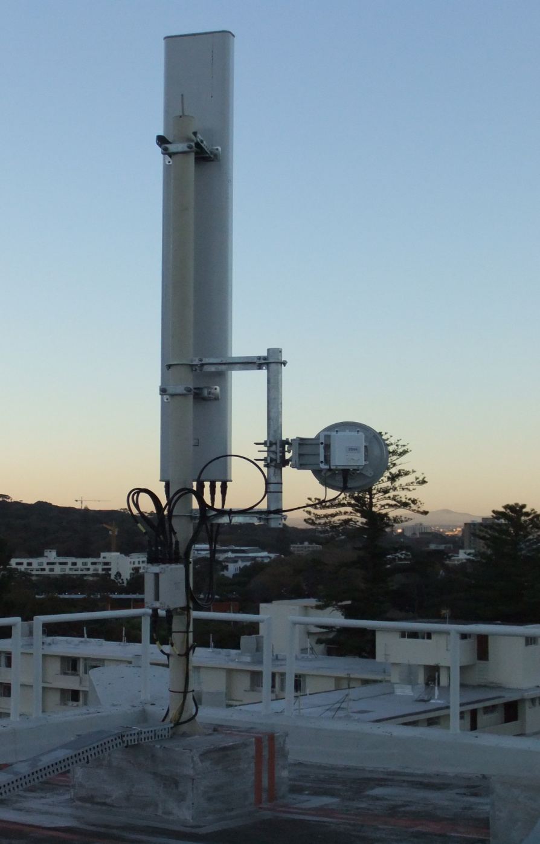
Building Your Transmission Backbone:

Slide 5
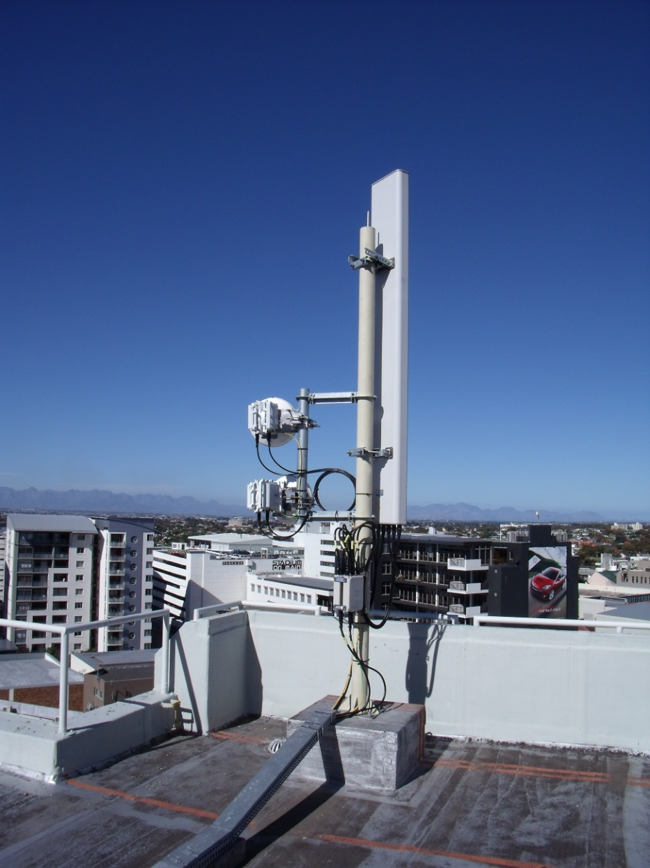

Management:
Etienne Simon Heinrich Scheepers
Corrie Jacson Together 65 years experience in Transmission Equipment specializing in Optical and Wireless technologies.

Slide 6

Completed Projects 2009/10:
DiTex RF Planning (CZ Elect, Telkom SA, WC & NC)
DiTex RF Installations. (CZ elect, Telkom SA, NC)
Wimax Site surveys BOM Planning. (Central region)
eMGW Site surveys BOM Planning. (Central region)
eMGW Installations (Saab Grintek ,Telkom SA ,WC)
eMGW Installations (Saab Grintek ,Telkom SA NC)
Nera MW Installations (Saab Grintek , Vodacom GP )
Tellabs installations (Saab Grintek Vodacom GP)
Nera Microwave installations (Saab Grintek , Vodacom NW )
3G RF & BTS upgrades (ZTE Cell-C WC)
ZTE Microwave installations (ZTE Cell-C WC)
Telkom Mobile 2G/3G RF & BTS installation.(Molapo Telkom Mobile WC)

Slide 7
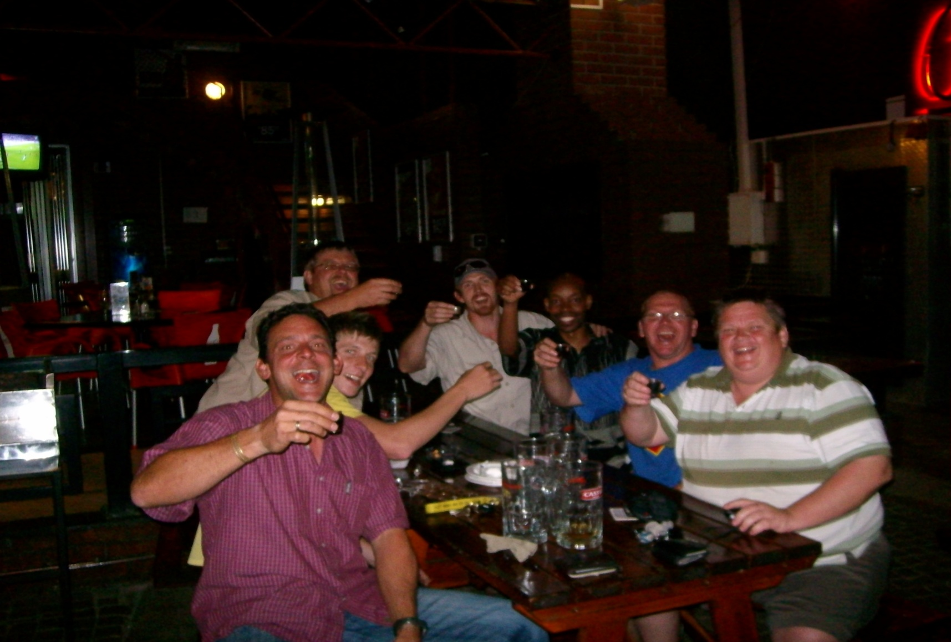
The Staff / Team Building:

Slide 8
Contact Details:
Etienne Simon
083 5588 475 (sel)
086 563 0222 (fax)
wicomcc2@gmail.com
wicomcc@gmail.com
Contact details:
Heinrich Scheepers
084 526 3560 (sel)
http://wicomcc.synthasite.com/
Vat Reg: 4740248762

